Slide 1
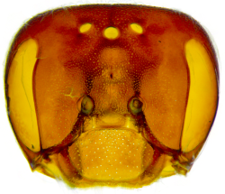
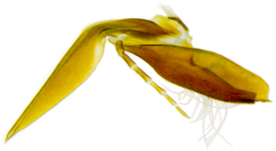
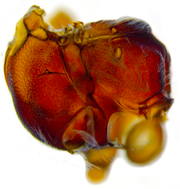
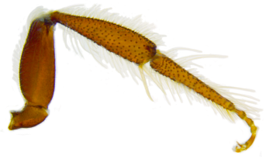
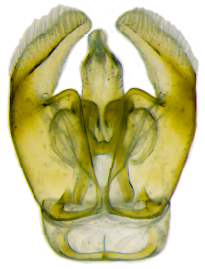
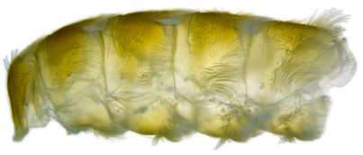
“Advanced” Topics in Morphological Evolution
Diego S. Porto
Postdoctoral Associate
Department of Biological Sciences
diegosporto@vt.edu
Photographs: D.S. Porto
Notes:
1. Cover.
2. Introduction.

Slide 2
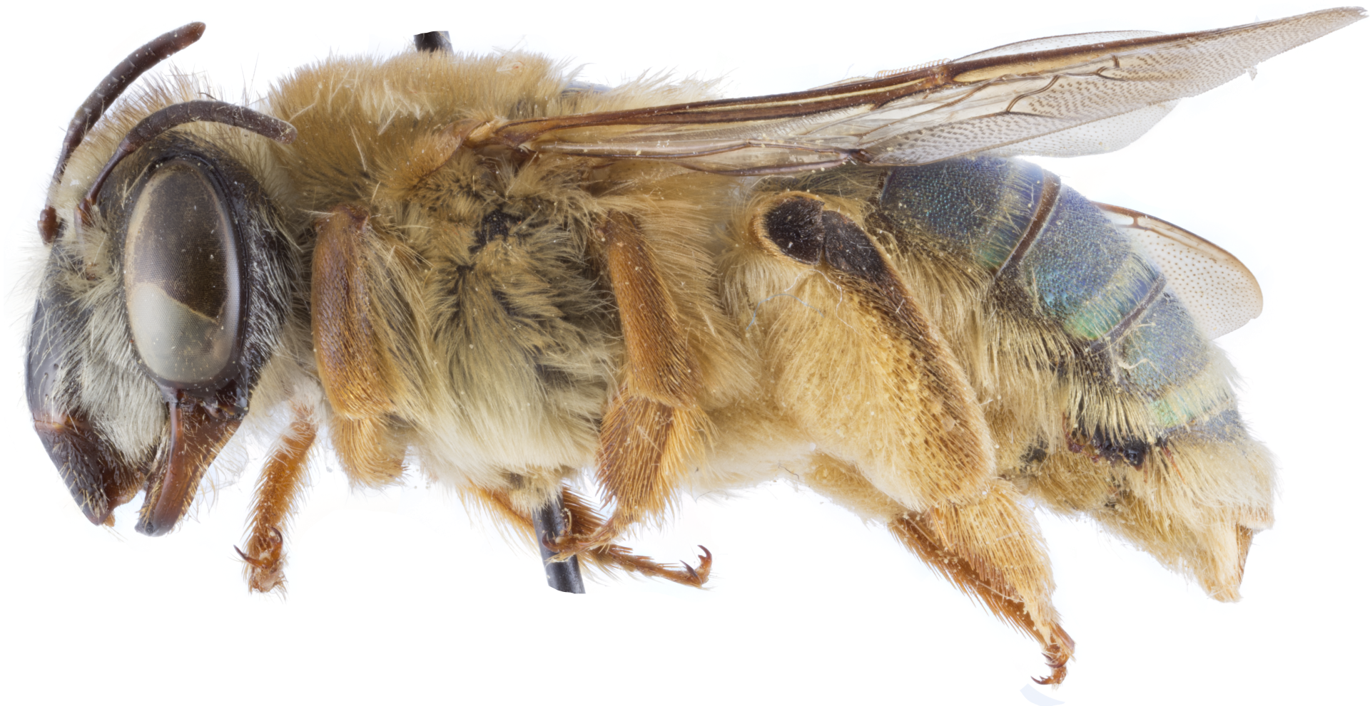
What my interests are?
Photograph: E.A.B. Almeida
Oxaea flavescens Klug, 1807
Notes:
1. Preface I: what interests me.

Slide 3
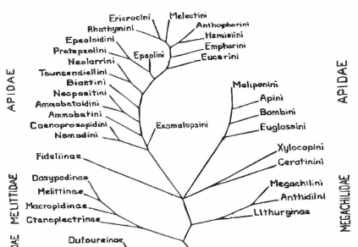
What my interests are?
?
Photograph: E.A.B. Almeida
Oxaea flavescens Klug, 1807
Notes:
1. Preface I: what interests me.

Slide 4
Overview
1. Morphological data in Bayesian analyses.
2. Extensions and additions to Mk model.
3. Exploiting the Bayesian ”machinery” to answer questions about morphological evolution.
Notes:
1. Preface II: what I am going to talk about (overview).

Slide 5
Morphological data in Bayesian analyses
Notes:
PART I: Break.

Slide 6
Particulars of morphological data
DNA:
1. Only 4 bases
2. Meaning across sites
3. Homology: alignment
4. Discrete
Morphology:
1. N states
2. No meaning across chars
3. Homology: expertise
4.1. Discrete:
- binary/multistate
- absence/presence
- qualities
4.2. Continuous:
- raw/ratios
Notes:
1. Preface III: molecular x morphological data.
2. Preface III: particulars of morphological data: discrete characters.

Slide 7
The ”pieces” of a Bayesian analysis
likelihood
prior
posterior
Pr(D|M) Pr(M)
Pr(M|D) =
observations
Pr(D)
0 0 1 0 1 1 0 1 1 1
marginal
 | 0 | 1
0
1
Ψ
ϴ
”reality”
Q
Photograph: D.S. Porto
Notes:
1. Preface IV: what are the pieces of a Bayesian analysis?

Slide 8
Bayesian Inference X Parsimony
Bayesian Inference:
1. Expected # substitutions
2. Shared branch lengths
3. Invariable sites
4. Posterior sample of trees
5. Posterior probability
Parsimony:
1. Minimum # changes
2. Individual branch lengths
3. Only variable characters
4. Most parsimonious tree
5. Bootstrap/Bremer
Notes:
1. Preface V: Parsimony x Bayesian Inference.

Slide 9
Mk model: instantaneous ratematrix (Q)
JC69
Mk (Lewis 2001)
 | A | C | G | T
A | -3β | β | β | β
C | β | -3β | β | β
G | β | β | -3β | β
T | β | β | β | -3β
 | 0 | 1 | ... | k
0 | 1 - k | 1 | ... | 1
1 | 1 | 1 - k | ... | 1
... | ... | ... | 1 - k | ...
k | 1 | 1 | ... | 1 - k
α
Notes:
1. Mk_Model: Introduction.

Slide 10
Mk model: assumptions
Assumptions of JC69:
1. All substitutions equally likely
2. Base frequencies equal
3. Every site has equal probability of substitution
4. Process is constant through time
5. Sites are independent of each other
6. Substitution is Markovian (memoryless)
7. All sites have the same evolutionary history
Notes:
1. Mk_Model: Basic assumptions.

Slide 11
Mk model: assumptions
Assumptions of Mk:
1. All changes equally likely
2. State frequencies equal
3. Every character has equal probability of change
4. Process is constant through time
5. Characters are independent of each other
6. Change is Markovian (memoryless)
7. All chars have the same evolutionary history
8. Only informative chars are included (usually).
Notes:
1. Mk_Model: Basic assumptions.

Slide 12
Extensions to Mk model
Notes:
PART II: Break.

Slide 13
Mk model: some tweaks we can make
Assumptions of Mk:
1. All changes equally likely (exchangeabilities)
2. State frequencies equal (equilibrium freqs.)
3. Every character has equal probability of change
4. Process is constant through time
5. Characters are independent of each other
6. Change is Markovian (memoryless)
7. All chars have the same evolutionary history
Notes:
1. Mk_Model: tweaks that can be made and relaxing some assumptions.

Slide 14
Mk model: some tweaks we can make
Assumptions of Mk:
1. All changes equally likely (exchangeabilities)
2. State frequencies equal (equilibrium freqs.)
3. Every character has equal probability of change
4. Process is constant through time
5. Characters are independent of each other
6. Change is Markovian (memoryless)
7. All chars have the same evolutionary history
Notes:
1. Mk_Model: tweaks that can be made and relaxing some assumptions.

Slide 15
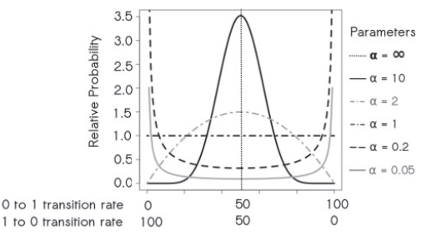
Tweak I: unequal char-state frequencies
Beta distribution
ratematrix (Q)
 | 0 | 1
0 | -μπ₀ | μπ₁
1 | μπ₀ | -μπ₁
Wright et al. (2016): Syst. Biol. 65: 602-611
π₀
π₁
0
1
Notes:
1. Tweak I: unequal character-state frequencies.

Slide 16
Mk model: some tweaks we can make
Assumptions of Mk:
1. All changes equally likely (exchangeabilities)
2. State frequencies equal (equilibrium freqs.)
3. Every character has equal probability of change
4. Process is constant through time
5. Characters are independent of each other
6. Change is Markovian (memoryless)
7. All chars have the same evolutionary history
Notes:
1. Mk_Model: tweaks that can be made and relaxing some assumptions.

Slide 17
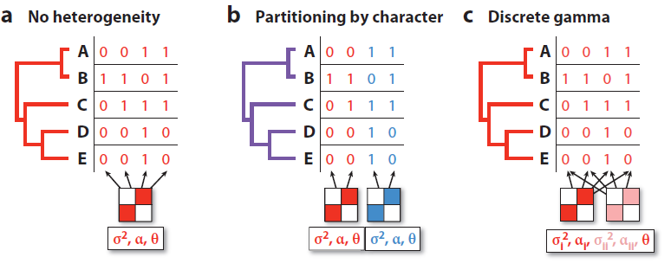
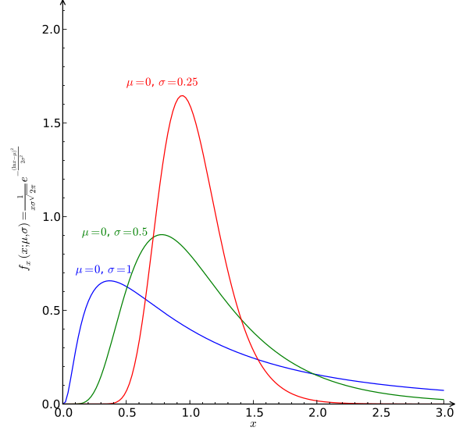
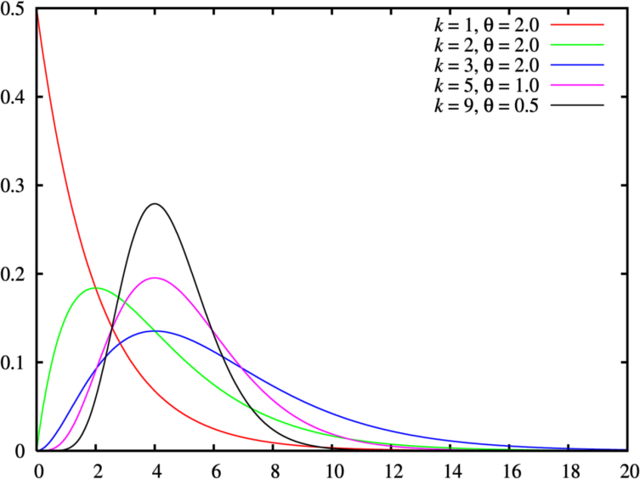
Tweak II: among-character rate var. (ACRV)
ACRV:
1. Shared or individual
2. More categories
3. Lognormal distribution
Lognormal distribution
O’Maera (2012): Annu. Rev. Ecol. Evol. Syst. 43: 267-285
Gamma distribution
Notes:
1. Tweak II: among-character rate variation (ACRV).

Slide 18
Tweak II: among-partition rate var. (APRV)
APRV:
1. Rate multipliers
2. Unlinked branch lengths
O’Maera (2012): Annu. Rev. Ecol. Evol. Syst. 43: 267-285
unlinked brlens
rate multipliers
P1
P2
P3
P1
P2
P3
branch length proportions
scale all branches
Notes:
1. Tweak II: among-partition rate variation (APRV).

Slide 19
Mk model: some tweaks we can make
Assumptions of Mk:
1. All changes equally likely (exchangeabilities)
2. State frequencies equal (equilibrium freqs.)
3. Every character has equal probability of change
4. Process is constant through time
5. Characters are independent of each other
6. Change is Markovian (memoryless)
7. All chars have the same evolutionary history
Notes:
1. Mk_Model: tweaks that can be made and relaxing some assumptions.

Slide 20
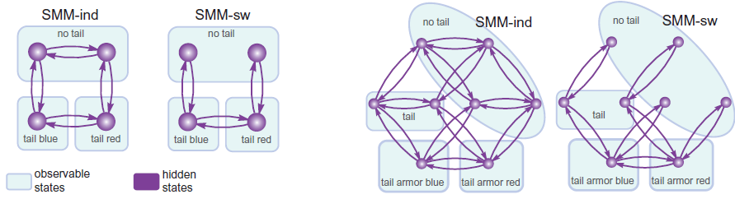
Tweak III: other Markovian Models
Hidden Markov Model (HMM) + Structured Markov Model (SMM)
2 characters
3 characters
TC | 00 | 01 | 10 | 11
00 | - | 1 | 1 | 0
01 | 1 | - | 0 | 1
10 | 1 | 0 | - | 1
11 | 0 | 1 | 1 | -
TC | 00 | 01 | 10 | 11
00 | - | 0 | 1 | 0
01 | 0 | - | 0 | 1
10 | 1 | 0 | - | 1
11 | 0 | 1 | 1 | -
SMM:
1. Correlations
2. Hierarchy
HMM:
1. Visible layer
2. Hidden layer
Tarasov (2019): Syst. Biol. doi:10.1093/sysbio/syz005
Notes:
1. Advanced Models II: Structured Markov Models (SMM).
2. Advanced Models III: Hidden Markov Models (HMM).

Slide 21
Mk model: some tweaks we can make
Assumptions of Mk:
1. All changes equally likely (exchangeabilities)
2. State frequencies equal (equilibrium freqs.)
3. Every character has equal probability of change
4. Process is constant through time
5. Characters are independent of each other
6. Change is Markovian (memoryless)
7. All chars have the same evolutionary history
Notes:
1. Mk_Model: tweaks that can be made and relaxing some assumptions.

Slide 22
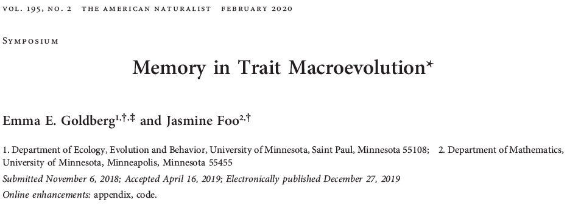
Tweak IV: renewal process (and others)
Goldberg & Foo (2020): Am. Nat. 195: 300-314
1. Renewal process
2. Threshold models
3. Random walk models
Notes:
1. Advanced Models II: Structured Markov Models (SMM).
2. Advanced Models III: Hidden Markov Models (HMM).

Slide 23
Mk model: some tweaks we can make
Assumptions of Mk:
1. All changes equally likely (exchangeabilities)
2. State frequencies equal (equilibrium freqs.)
3. Every character has equal probability of change
4. Process is constant through time
5. Characters are independent of each other
6. Change is Markovian (memoryless)
7. All chars have the same evolutionary history
Notes:
1. Mk_Model: tweaks that can be made and relaxing some assumptions.

Slide 24
Exploiting the Bayesian ”machinery”
Notes:
PART III: Break.

Slide 25
Exploiting the Bayesian ”machinery”
History 1
History 2
gene regulatory networks (GRN)
Photographs: D.S. Porto
Notes:
1. Anatomical modules: general ideas.

Slide 26
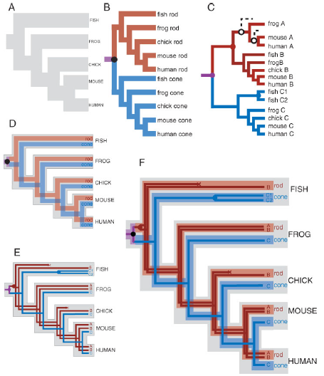
Exploiting the Bayesian ”machinery”
History 1
History 2
evolutionary modules
gene regulatory networks (GRN)
Photographs: D.S. Porto
Serb & Oakley (2005): Bioessays 27:1158-1166
Notes:
1. Anatomical modules: general ideas.

Slide 27
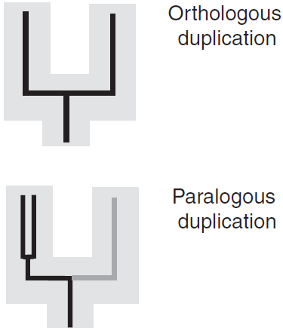
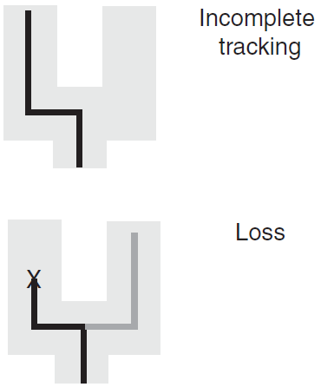
Exploiting the Bayesian ”machinery”
Serb & Oakley (2005): Bioessays 27:1158-1166
Notes:
1. Anatomical modules: general ideas.

Slide 28
Bayesian Machinery: Information Theory
Information Theory: Entropy (Shannon 1948)
PRIOR
1. more uncertainty
2. higher entropy
3. equiprobable outcomes
POSTERIOR
1. less uncertainty
2. lower entropy
3. unequal probability
Notes:
1. Information Theory I: Entropy, Prior, Posterior.

Slide 29
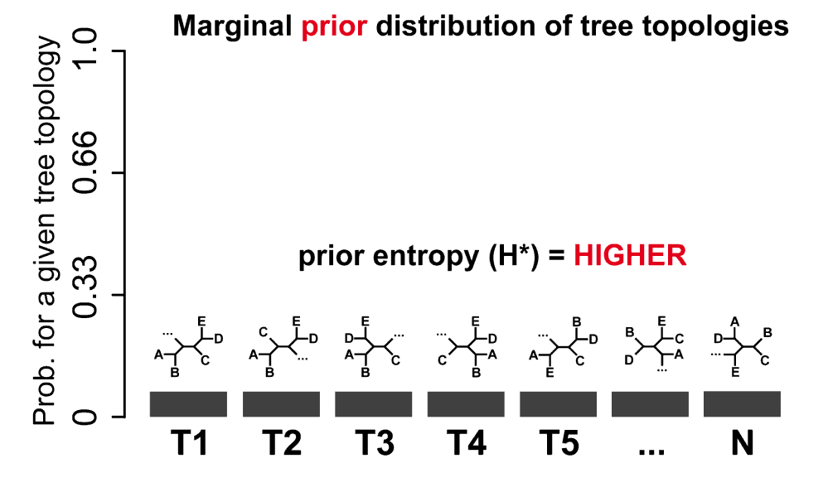
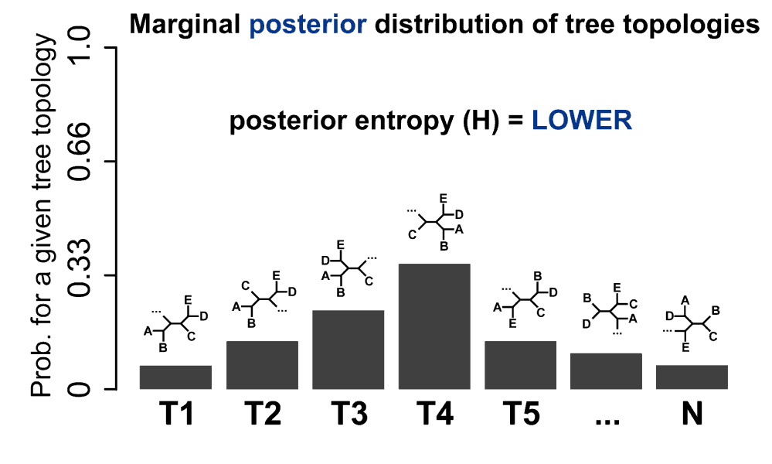
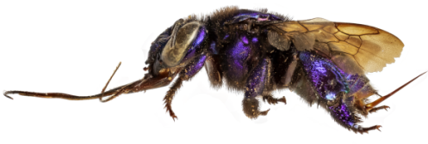
Bayesian Phylogenetic Information (BPI)
Information
(Lindley 1953)
I = H* - H
PRIOR
+
DATA
=
POSTERIOR
Photograph: D.S. Porto
Notes:
1. Information Theory II: Bayesian Phylogenetic Information (BPI).

Slide 30
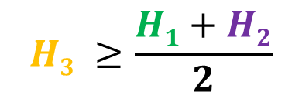
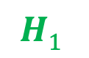
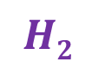
Phylogenetic dissonance (= conflict)
 | T1 | T2 | T3 | T4 | T5 | T6 | T7 | T8 | T9 | T10
sp1
sp2
sp3
sp4
F1
F2
F1
F2
F3
$$H3 ≥\frac{H1+H2}{2}$$
$$H\text{1}$$
$$H2$$
Photographs: D.S. Porto
Notes:
1. Information Theory III: Phylogenetic Dissonance.

Slide 31
Applications: some examples
Notes:
PART IV: Examples.

Slide 32
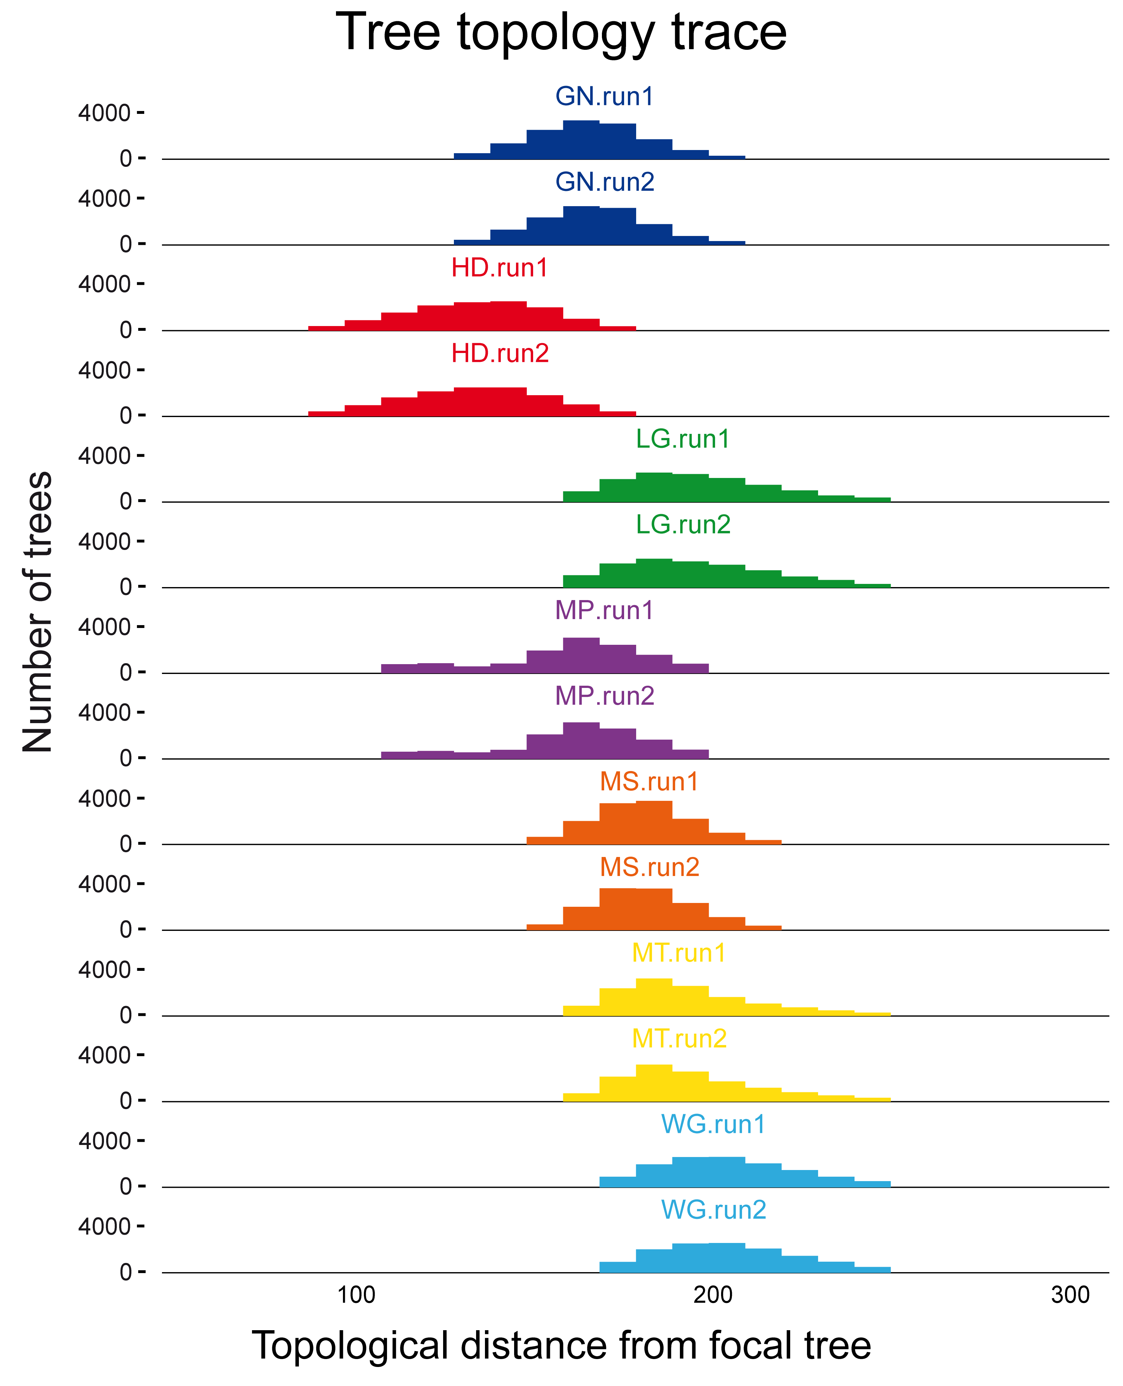
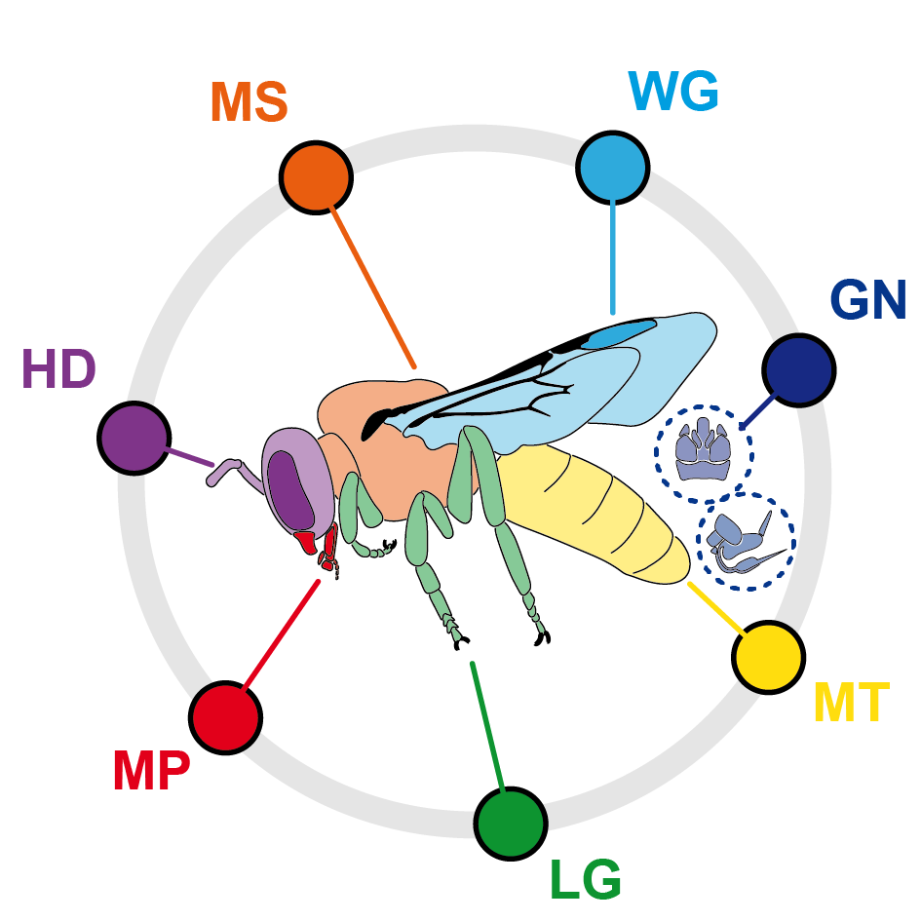
Example I: information content
anatomical partitions
Porto et al. (2020): Syst. Biol.
Notes:
1. Example I: assessing information content of morphological data.

Slide 33
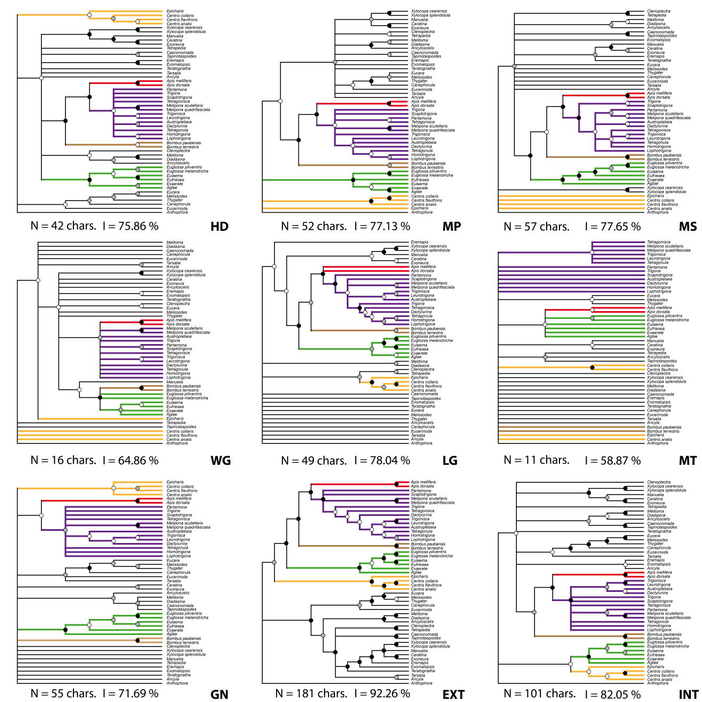
Example II: conflict among partitions
”structure trees”
Porto et al. (2020): Syst. Biol.
Notes:
1. Example II: detecting informational conflict among anatomical partitions.

Slide 34

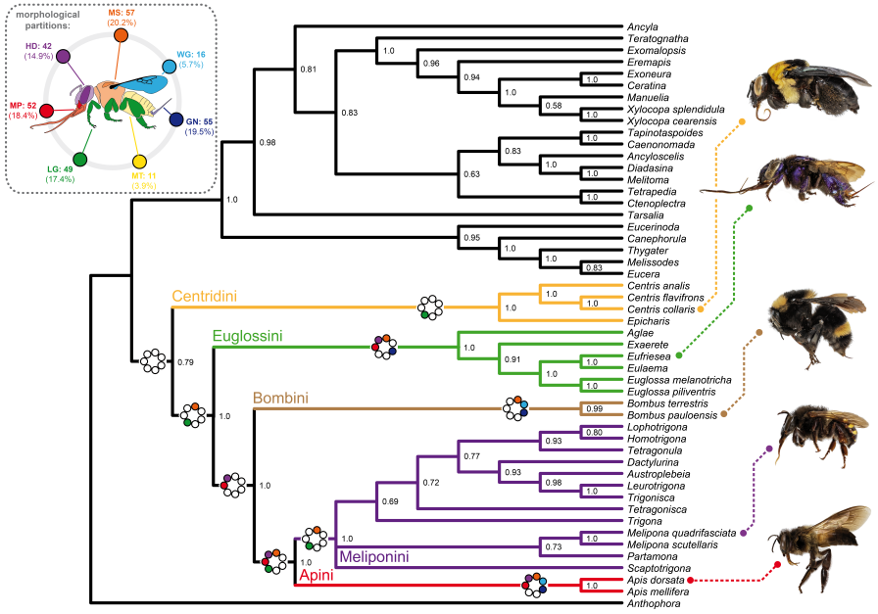
Example II: conflict among partitions
species tree
”structure trees”
Porto et al. (2020): Syst. Biol.
Notes:
1. Example II: detecting informational conflict among anatomical partitions.

Slide 35

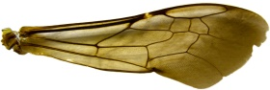
Example III: address evolutionary hypotheses
Anatomy1
Function1
D1
D1
Anatomy2
Function2
D2
D2
Photographs: D.S. Porto
Notes:
1. Example III: testing evolutionary hypotheses.

